Slide 1
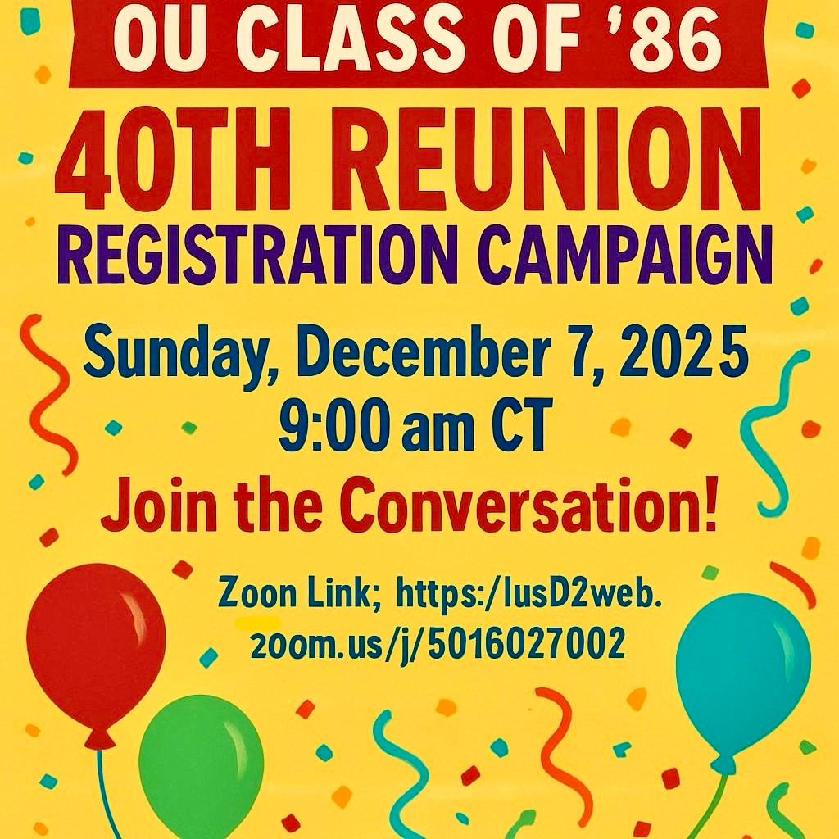


https://bit.ly/zoomnation

Slide 2
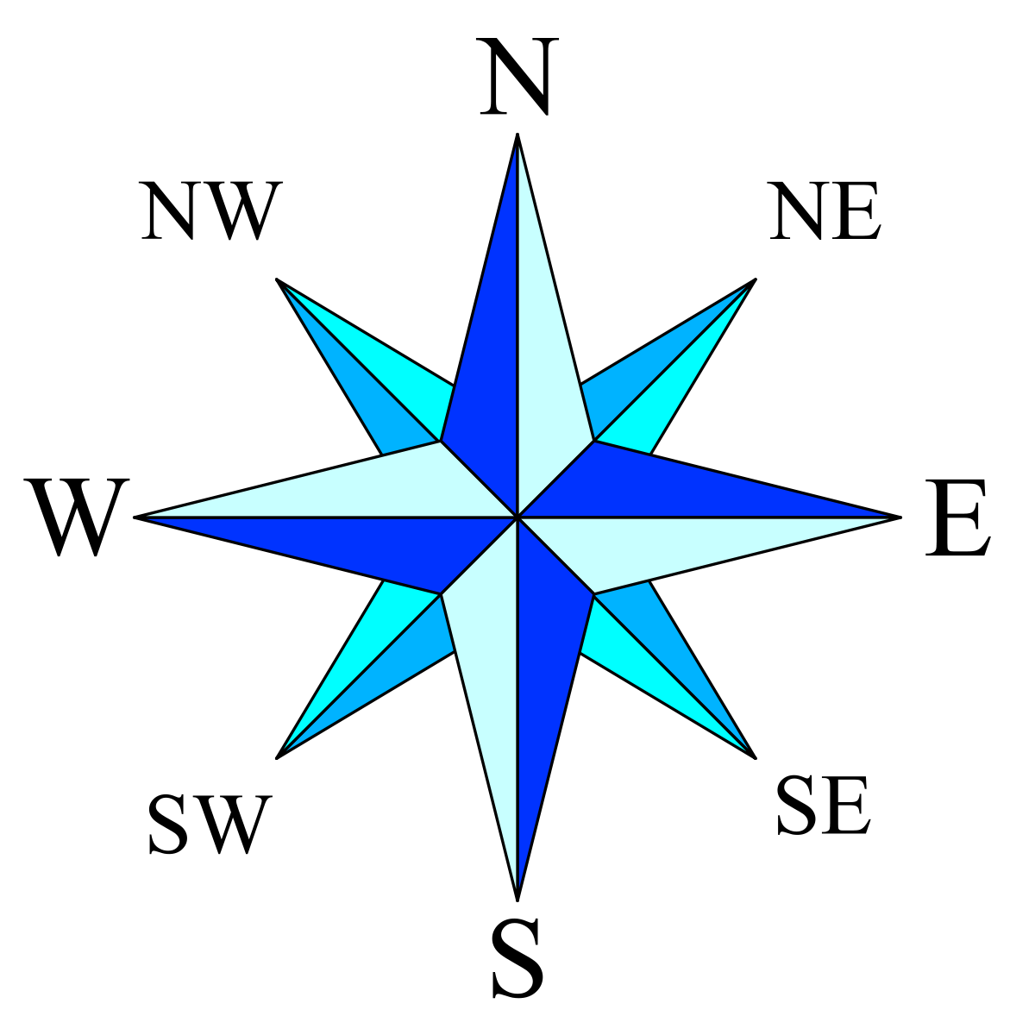


What’s up?
What’s your city?
What’s the weather?
Cloudy | 34/53° | Huntsville, AL

Slide 3
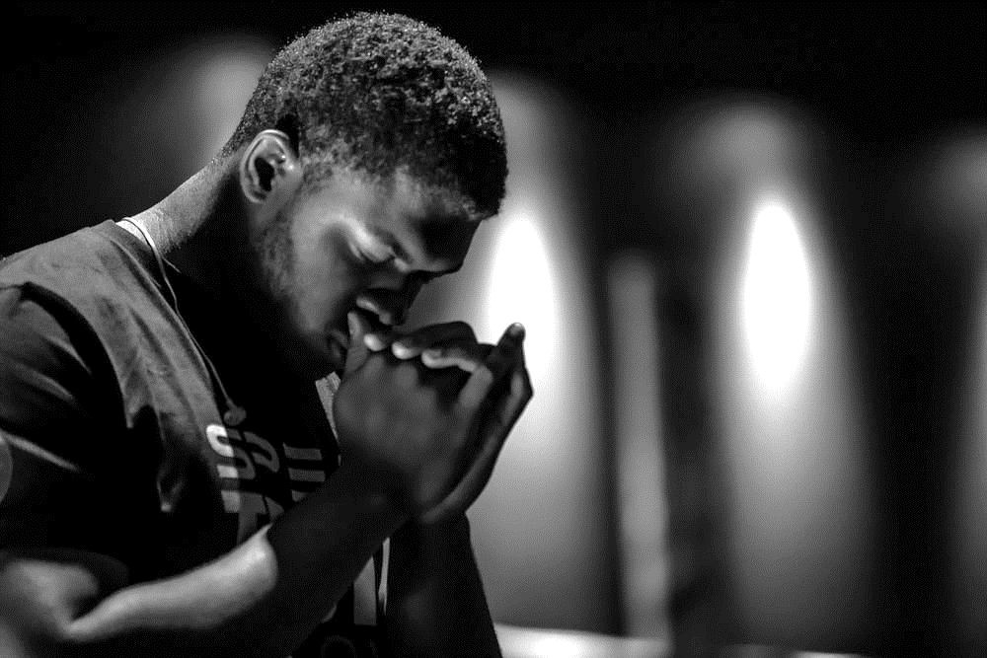


Elder Philip
Your Hearts Desire From His Open Hand
Prayer

Slide 4


PROMPT: What aspect of winter do like the most?

Slide 5
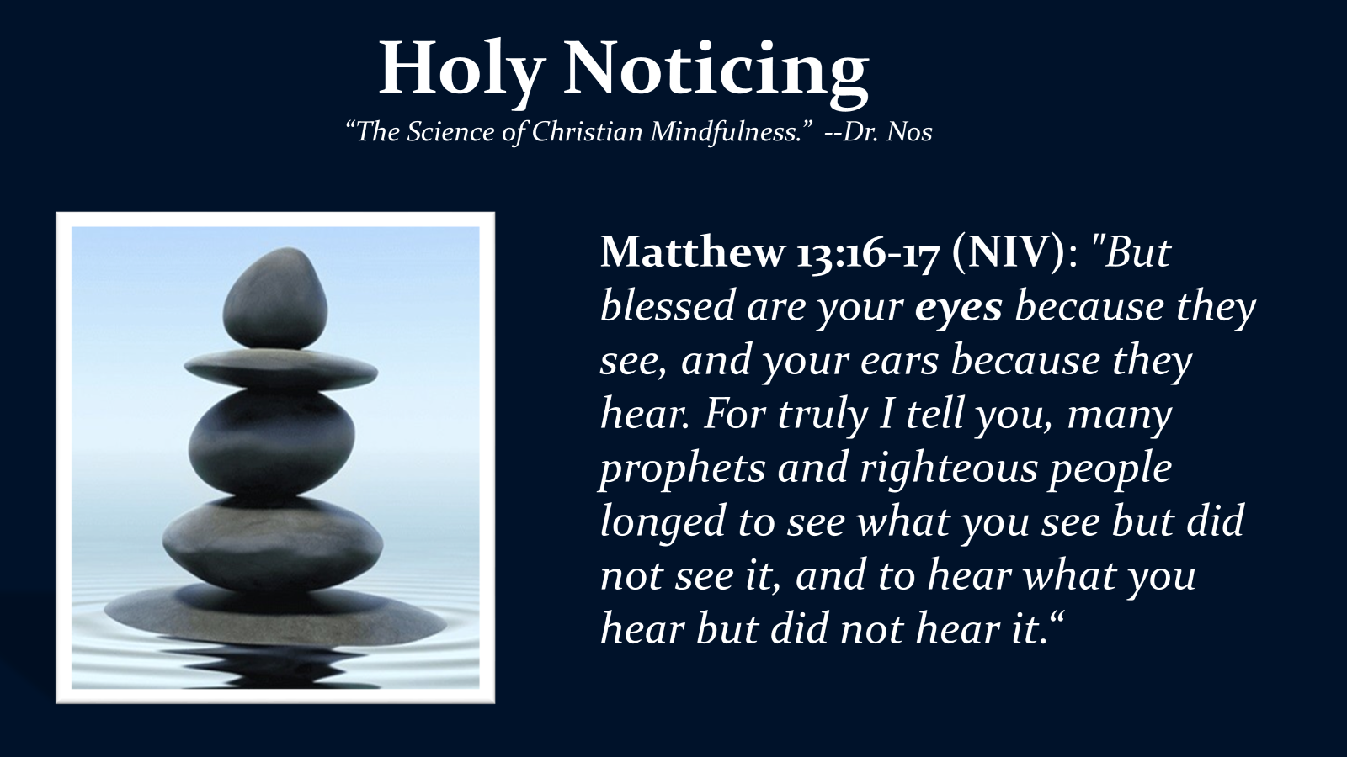

Slide 6


Slide 7
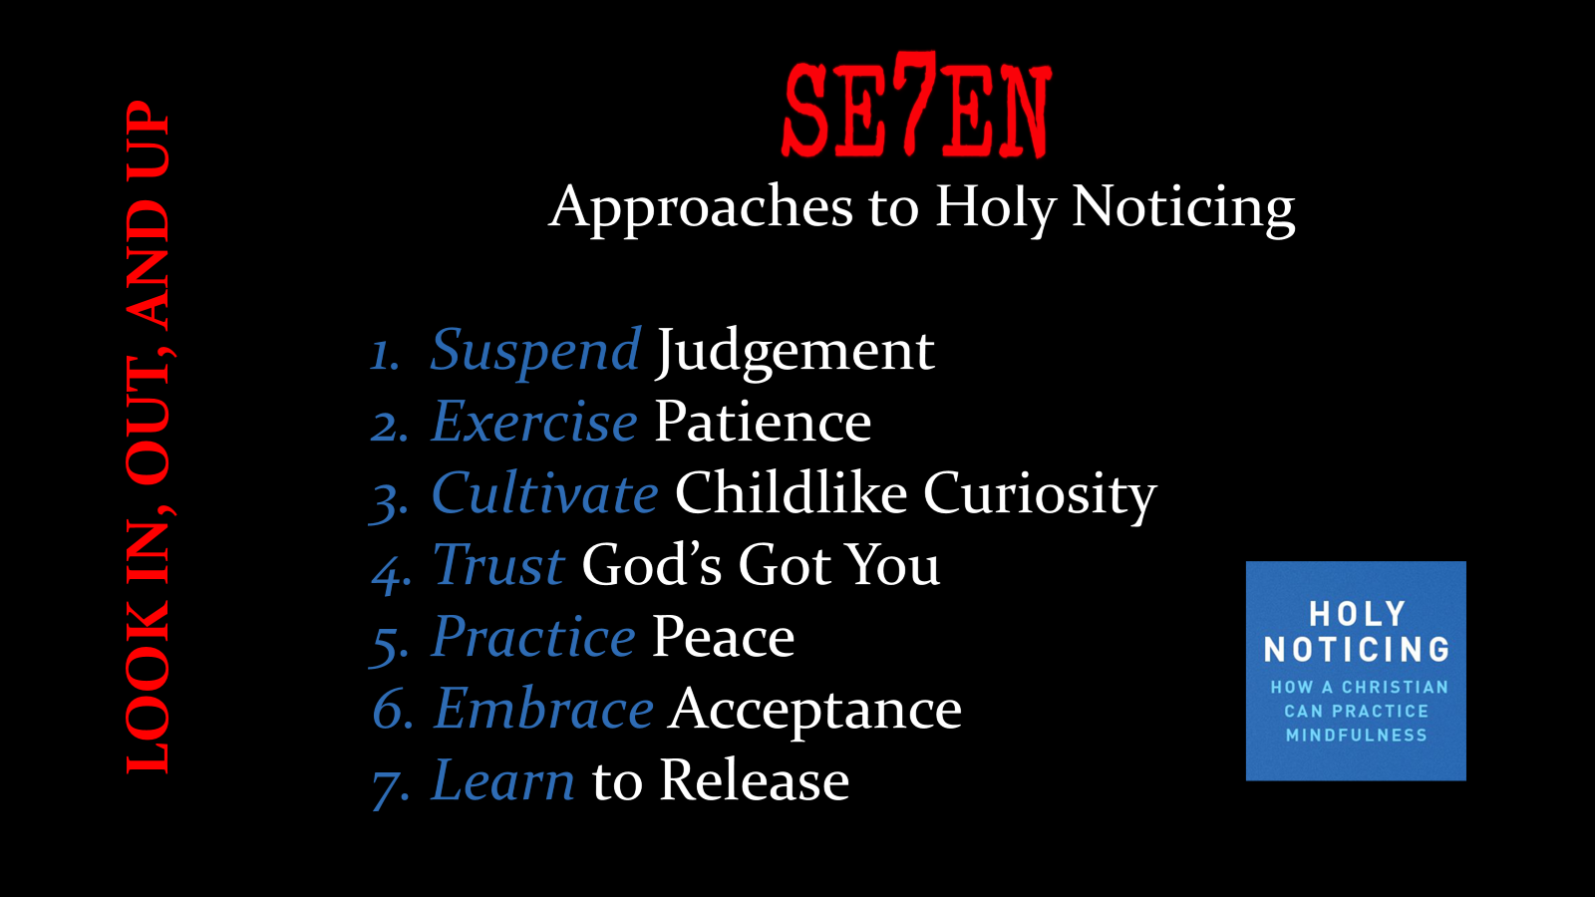

Slide 8
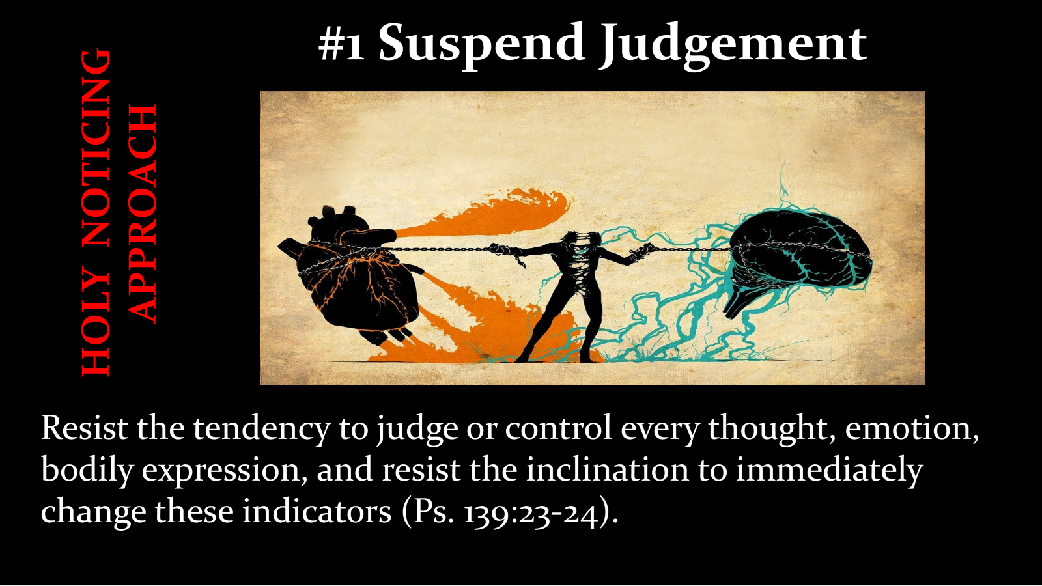

Slide 9
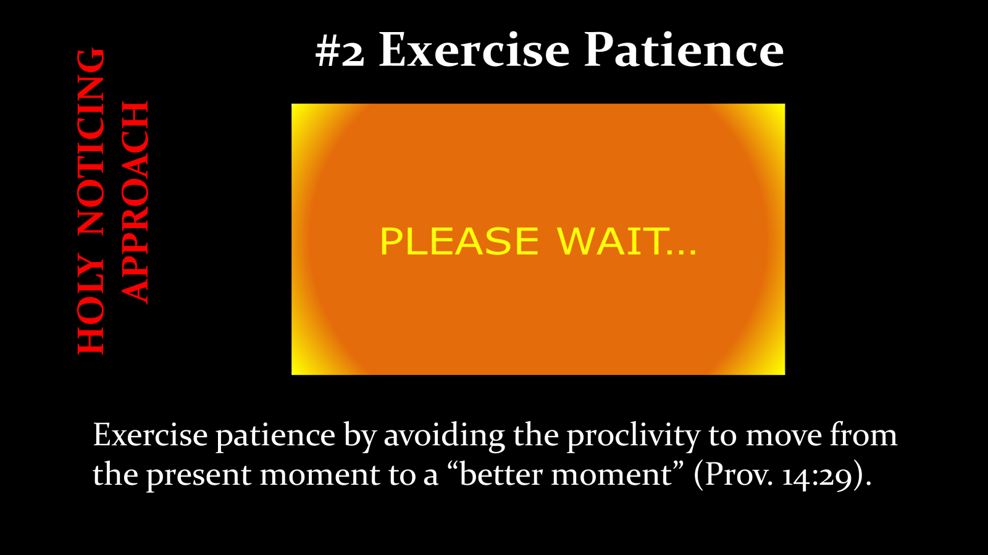

Slide 10


Slide 11


Slide 12


Slide 13


Slide 14


Slide 16



Slide 17

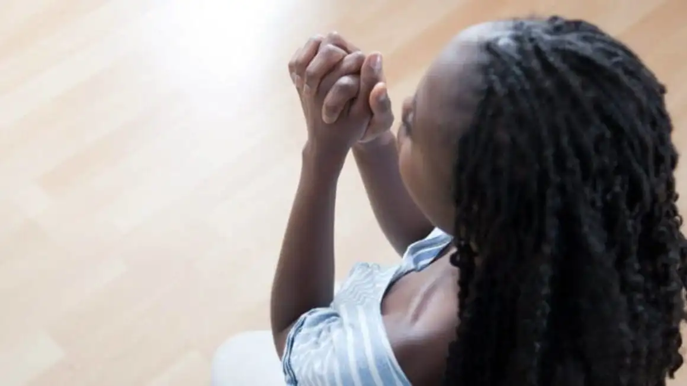
The Prayers of the Righteous…

Slide 18
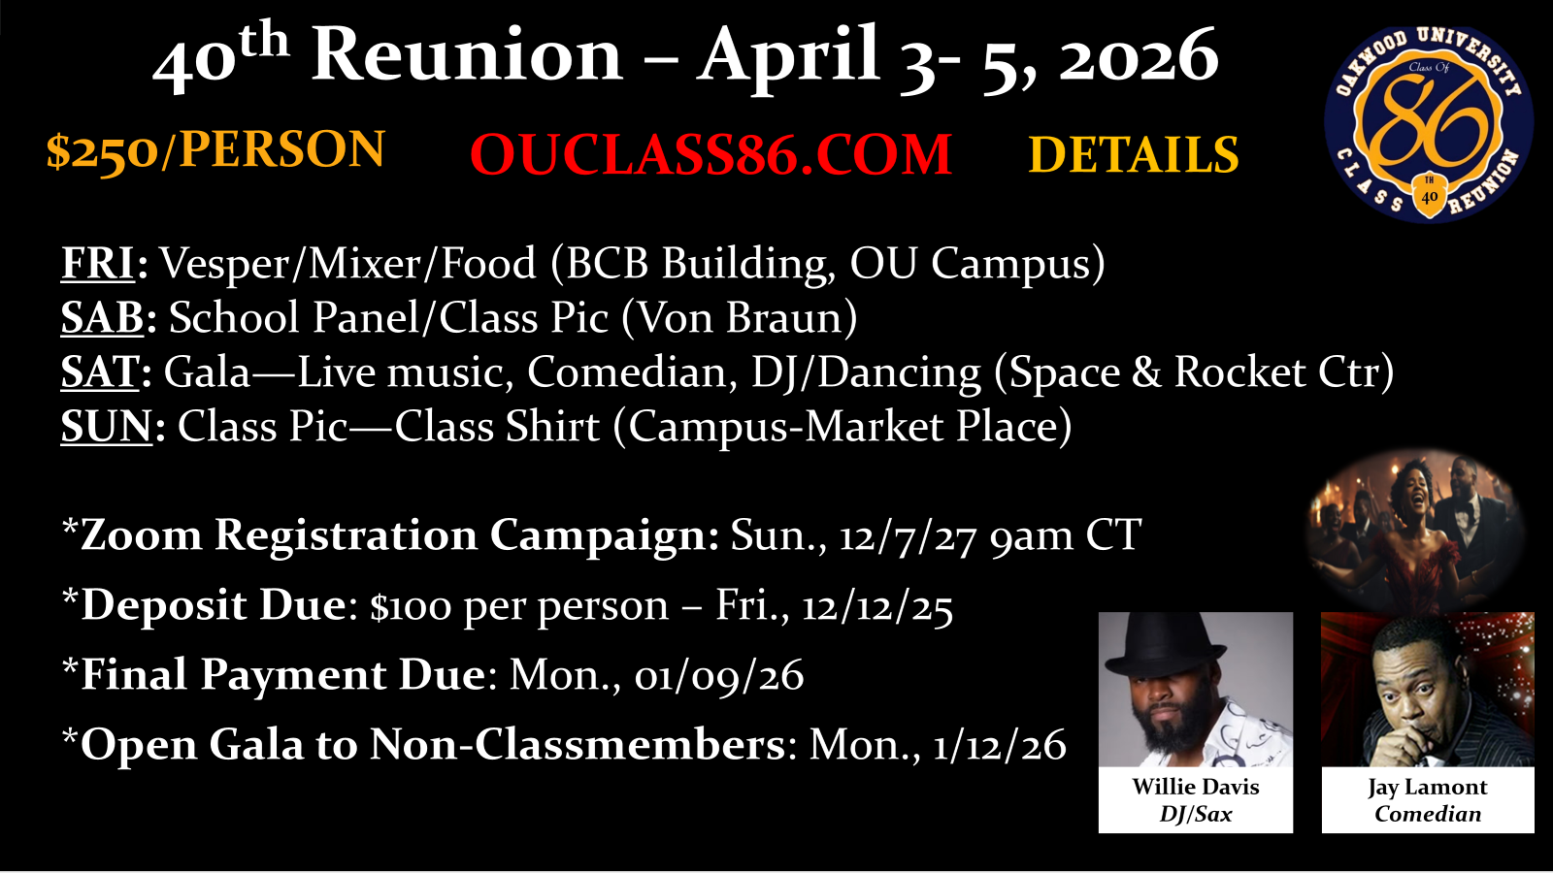

Slide 19

40th Reunion – April 3- 5, 2026
Registered w/ Deposit
Ivan Allston, James Benjamin, Brenda (Huley) Brame, Joe Follette, Melody Germany, Deanna Guthrie, James Harris, Pam Harraway, Melvin Hardy, Princess Hawk, Nia Henley, Lynda Hodges, Marecha Jackson,
Robin Langley, Pat Lennox, Charlene Lester, Christel Lobbins, Calvin Mann, Sharon Robles, Juanita Parker Smith, Lisa Stone, Nosakhere Thomas, Chevelle Watson, Sherrell Bihm, Cheryl Joseph-Sonceau, Ellis Sheppard, Phyllis Winston-Dyer, Jacqueline (Mitchell) Adiele, Sherry Allen, Deloris Washington, Cleveland Hobdy, Yehoyada Mbangukira
- 32 -
Notes:
TRUST God’s unfailing love. The love of God is not going to let you fall. The love of God is not going to let you fail. Rom. 8 more than conquerors through His love. Nothing can separate us from His love.
Suspend Judgement;
2. Exercise Patience;
3. Cultivate Childlike Curiosity;
4. Trust God’s God You;
5. Practice Peace;

Slide 20

Diamond Jubilee
Notes:
California state lawmakers have introduced a series of bills aimed at providing reparations to Black Americans who have been adversely affected by systemic racism.
The proposed measures include the restoration of property previously seized through racially-biased eminent domain cases and the allocation of state funding to specific groups.
This legislative package represents the first-of-its-kind initiative in the nation and is the outcome of extensive research and discussions, including the issuance of a 111-page recommendation report by a task force last year.

Slide 21
https://bit.ly/zoomnation

Slide 22



Slide 23
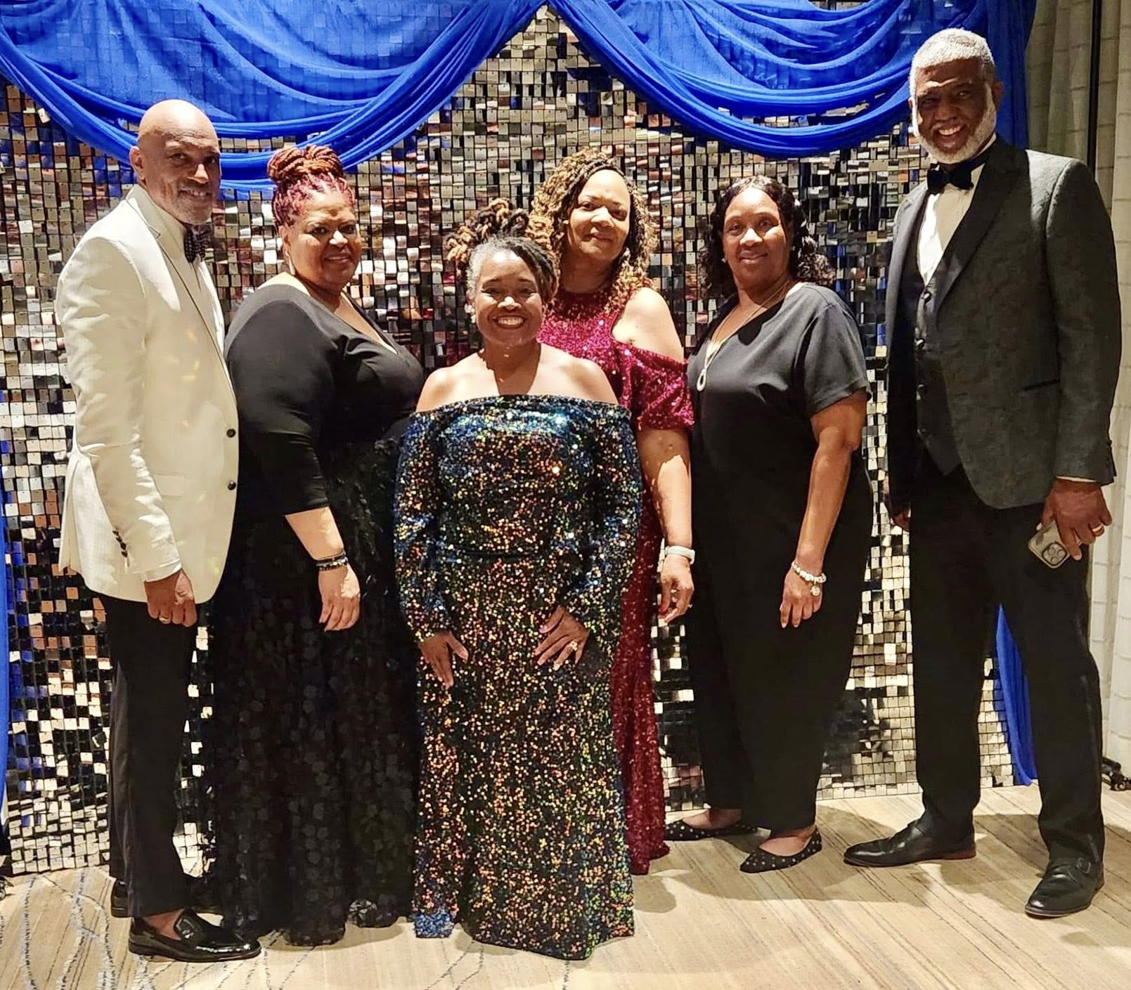

60th Birthday Party Gala
Ft. Lauderdale
July 18-21, 2025

Slide 24
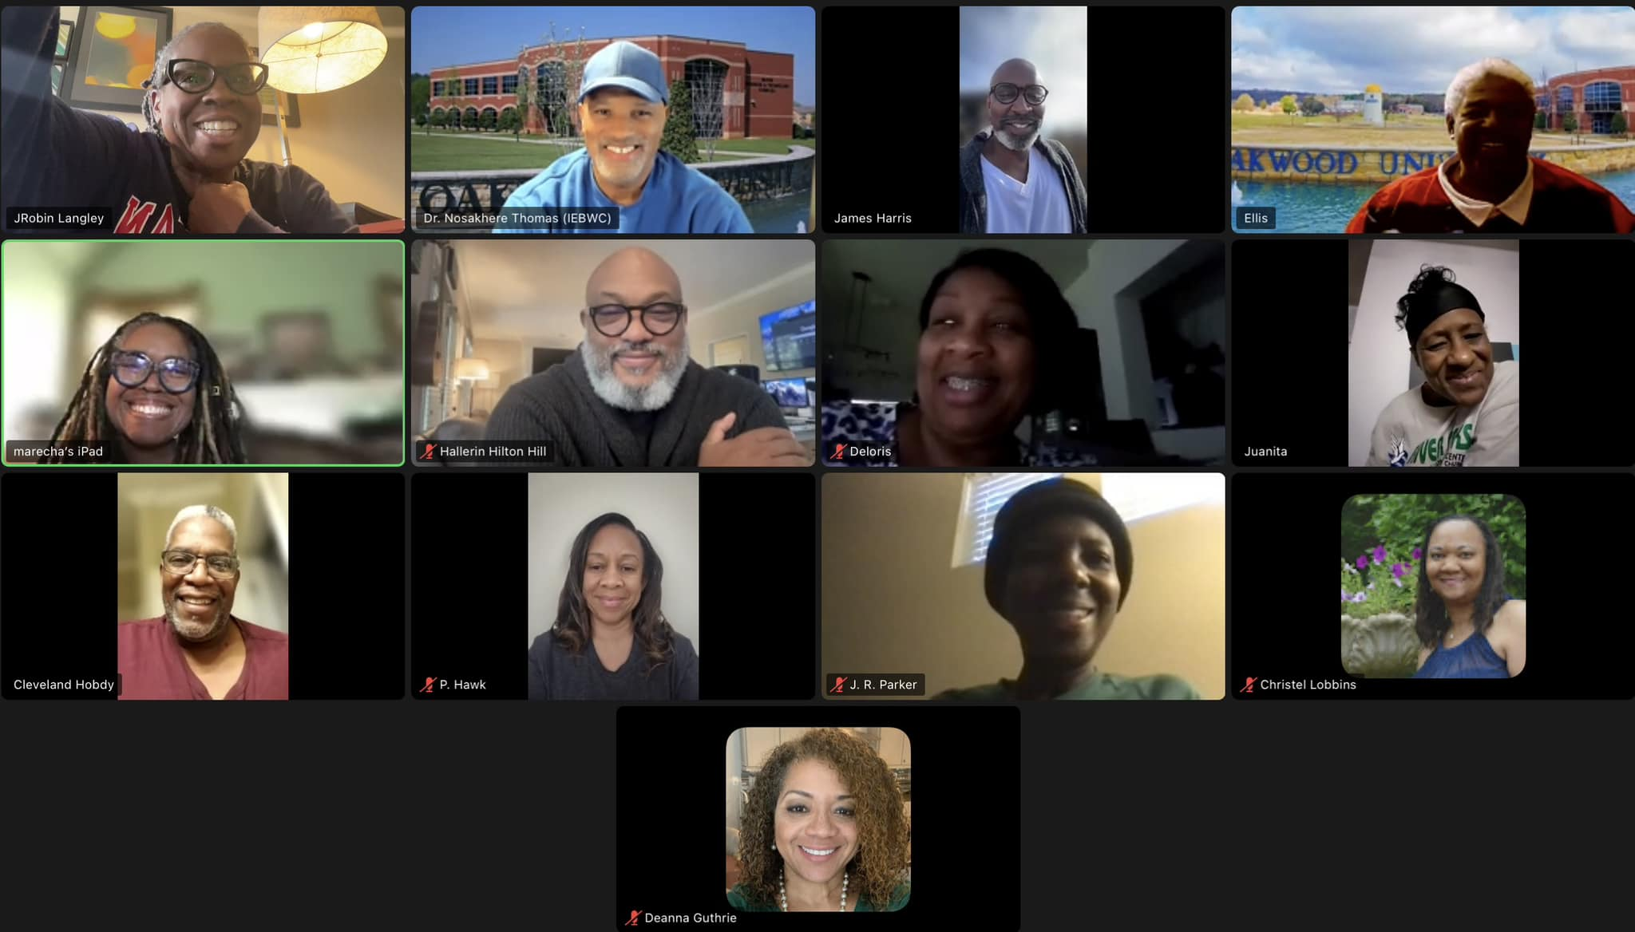

Slide 25
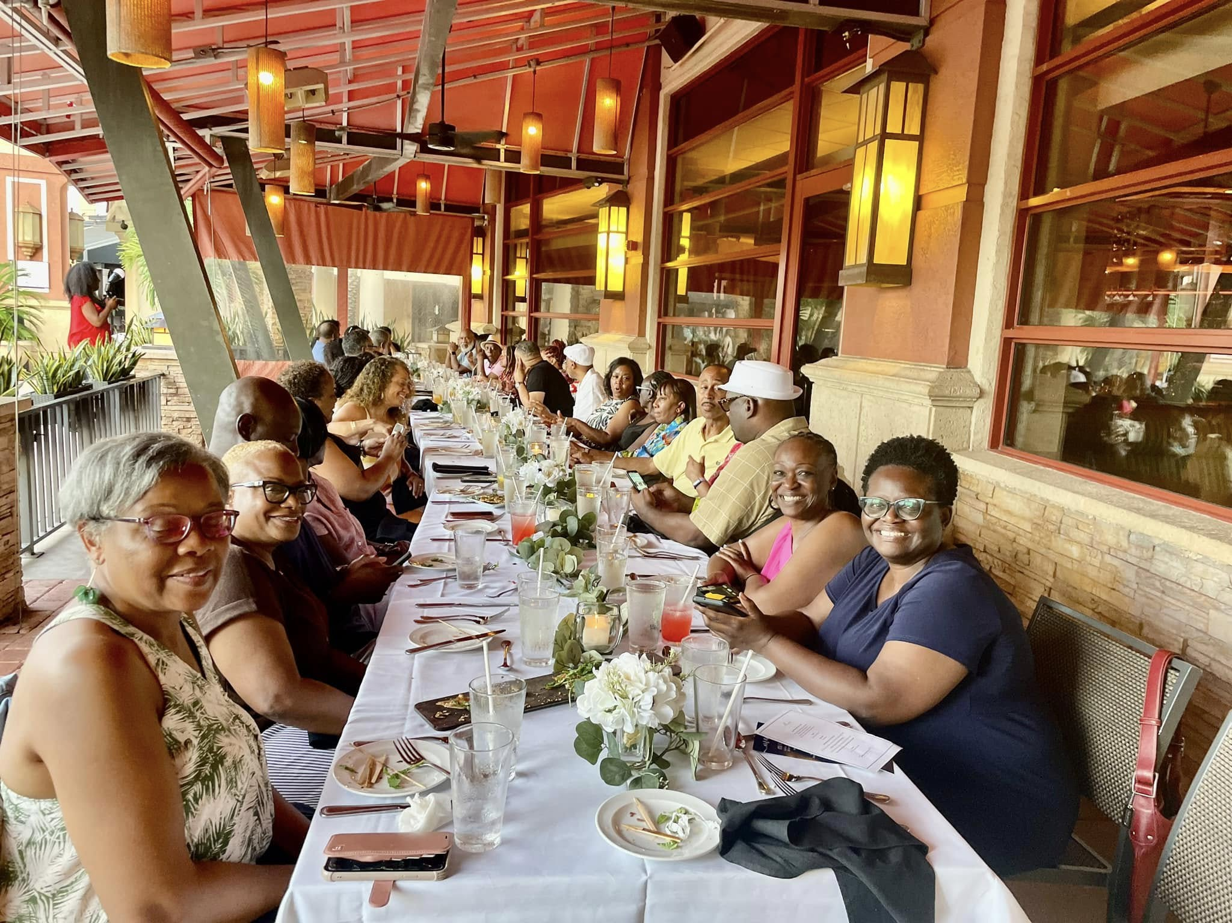
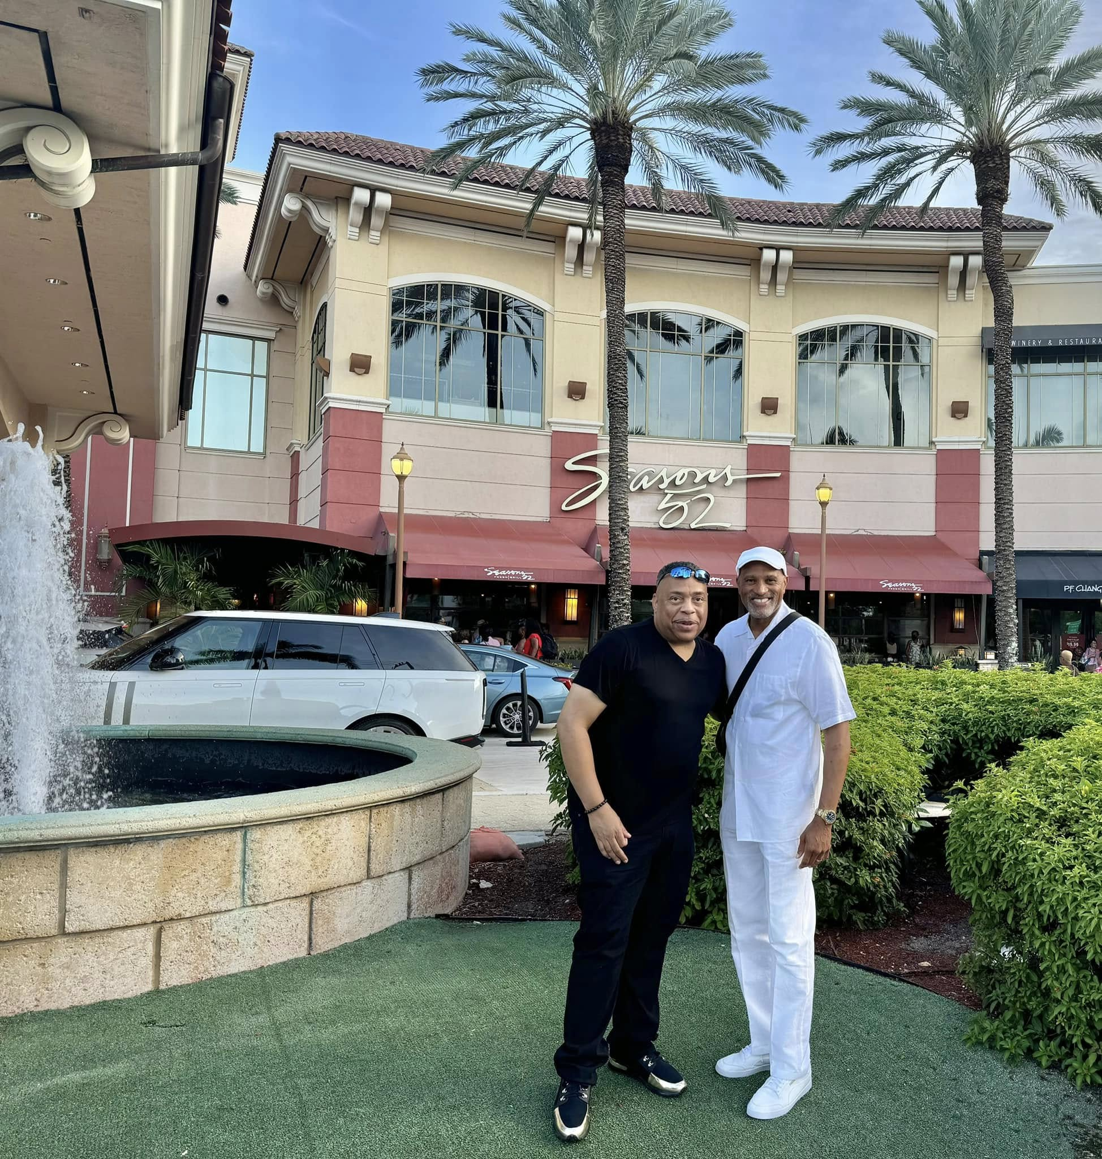
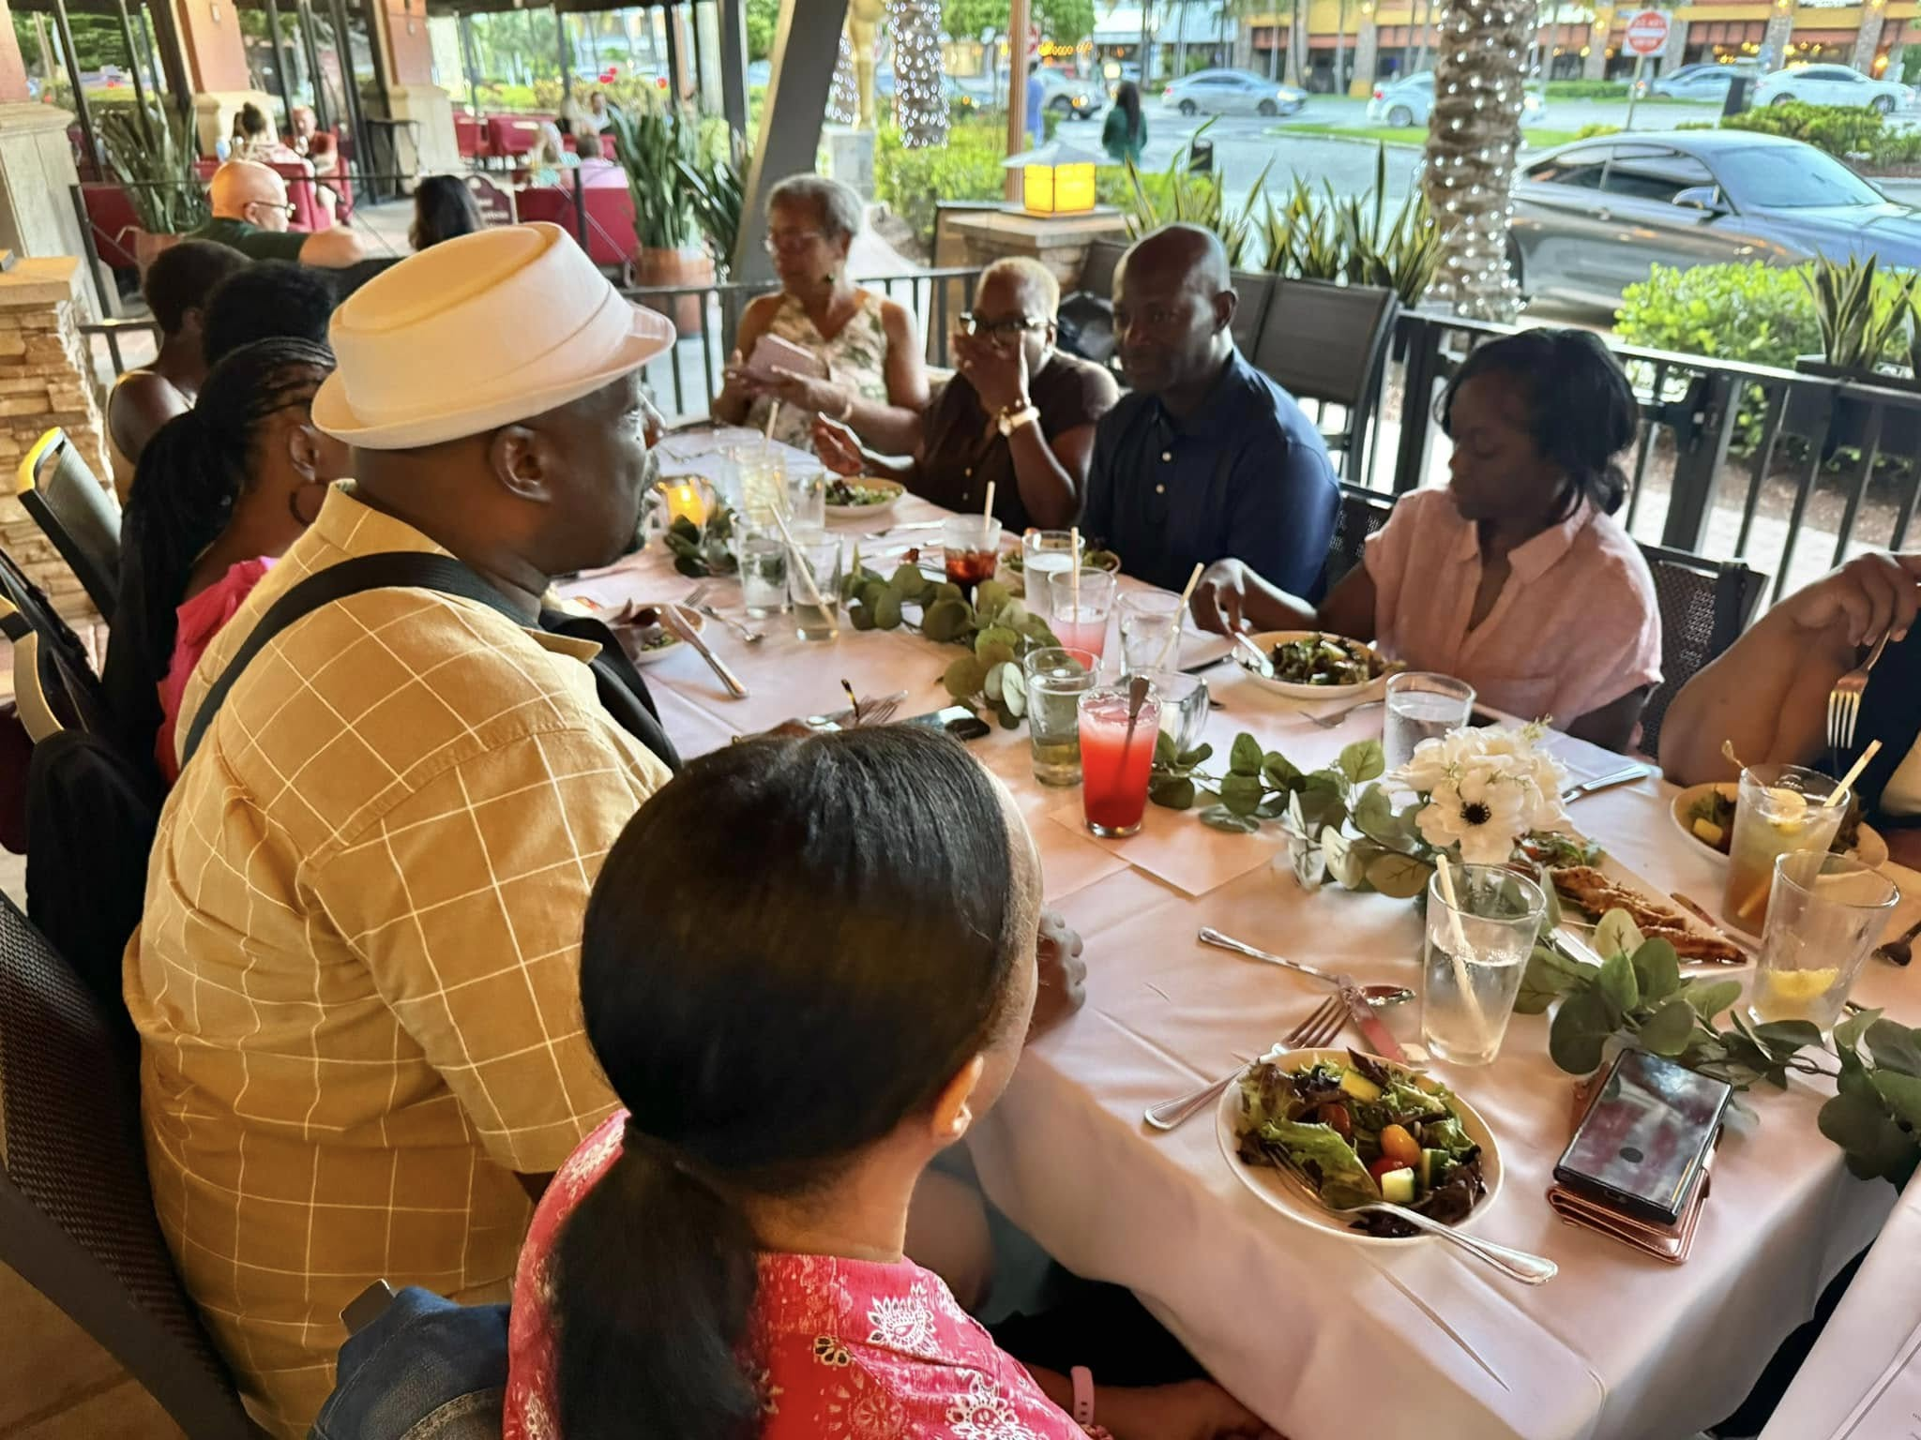

Slide 26
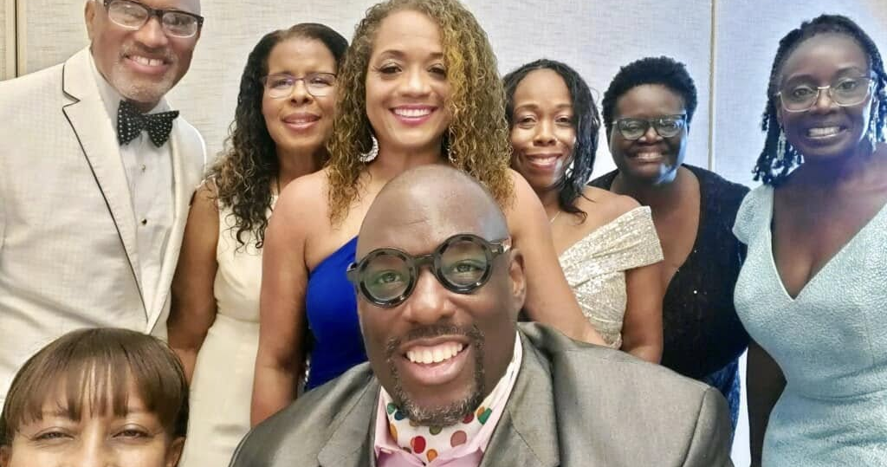

Slide 27
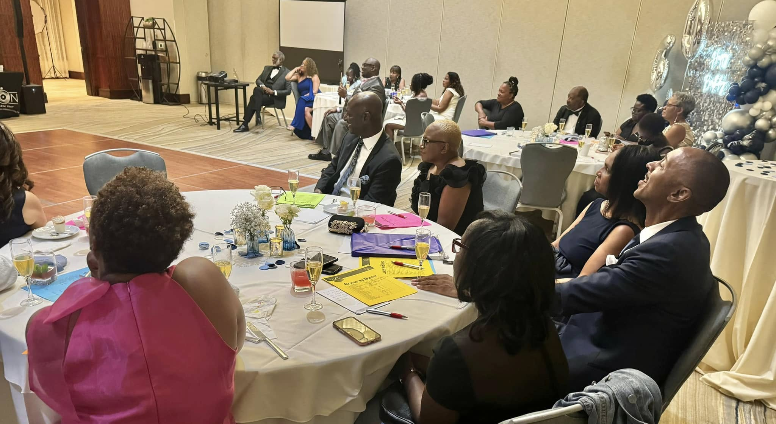

Slide 28
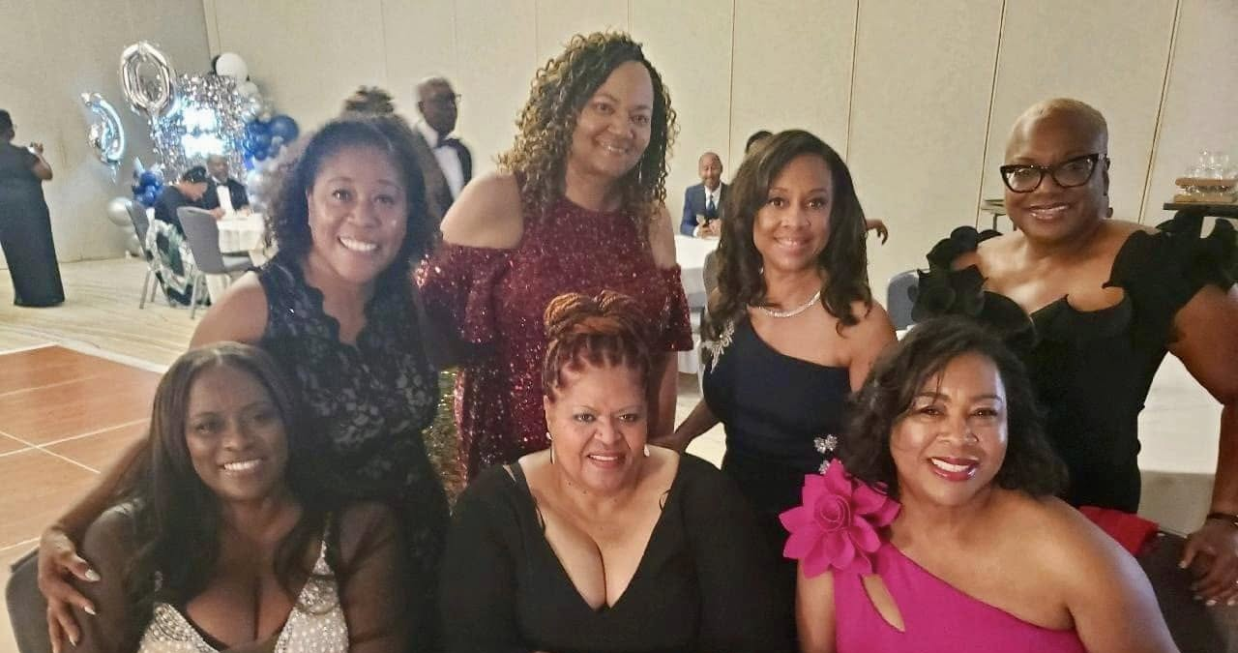

Slide 29
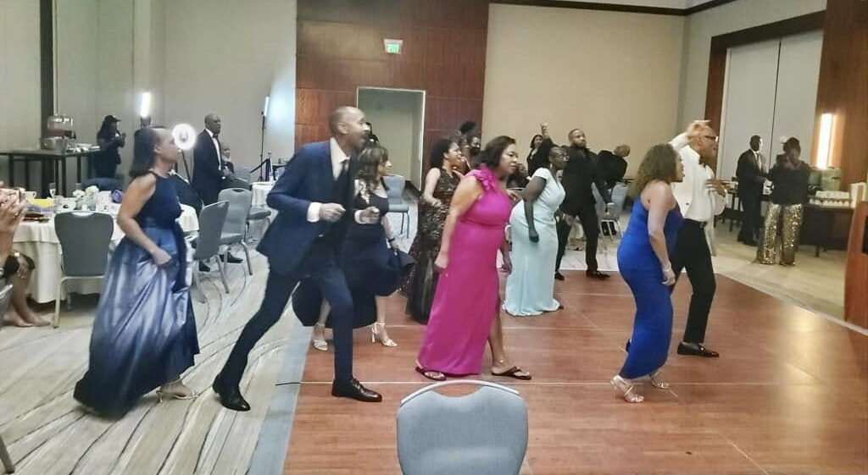

Slide 30
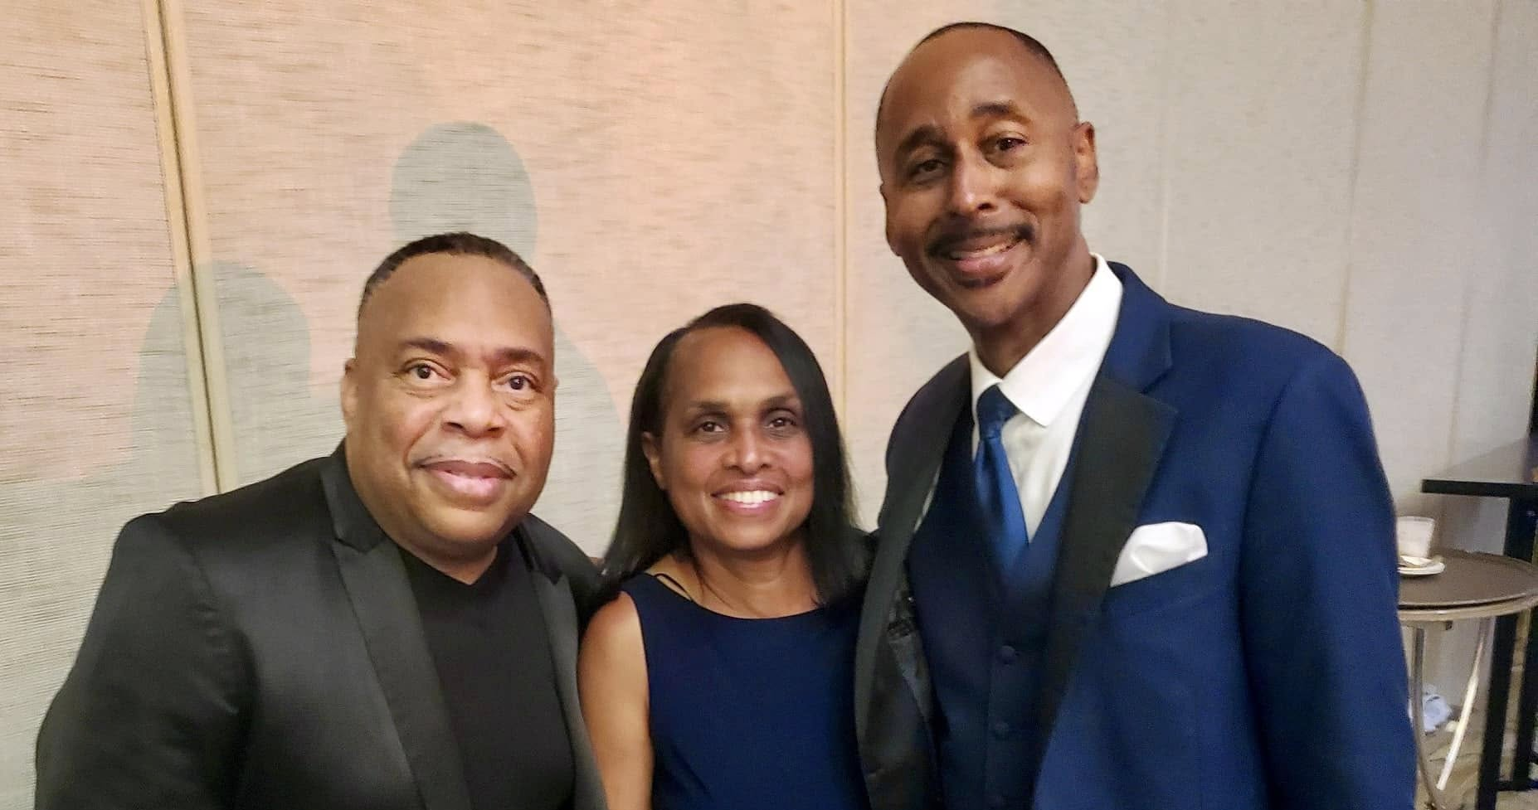

Slide 31
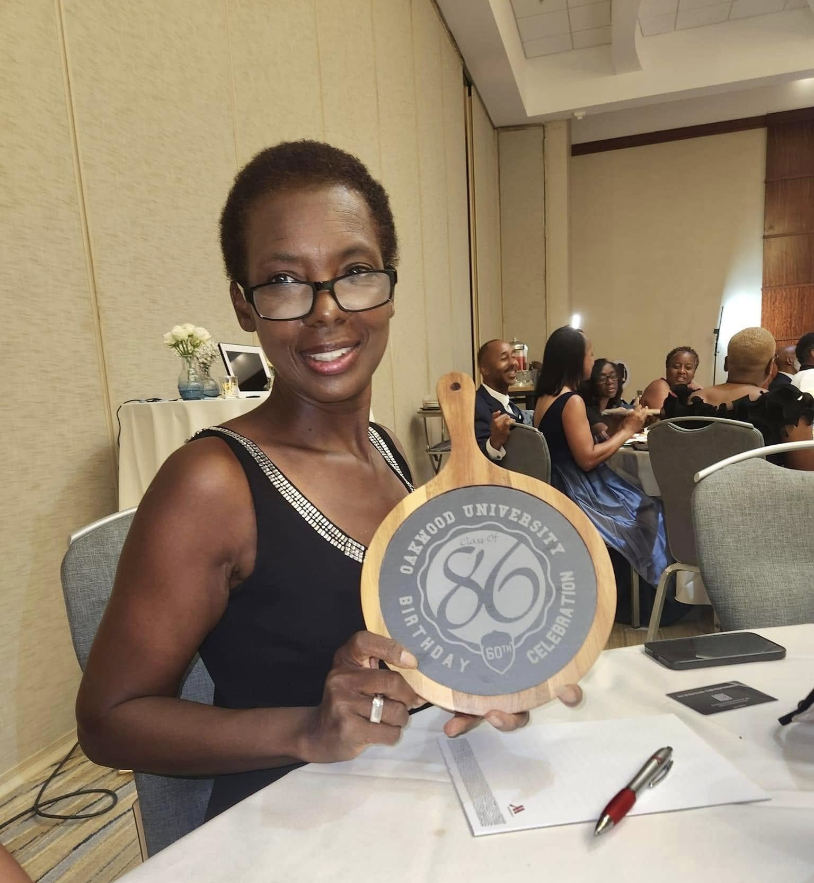
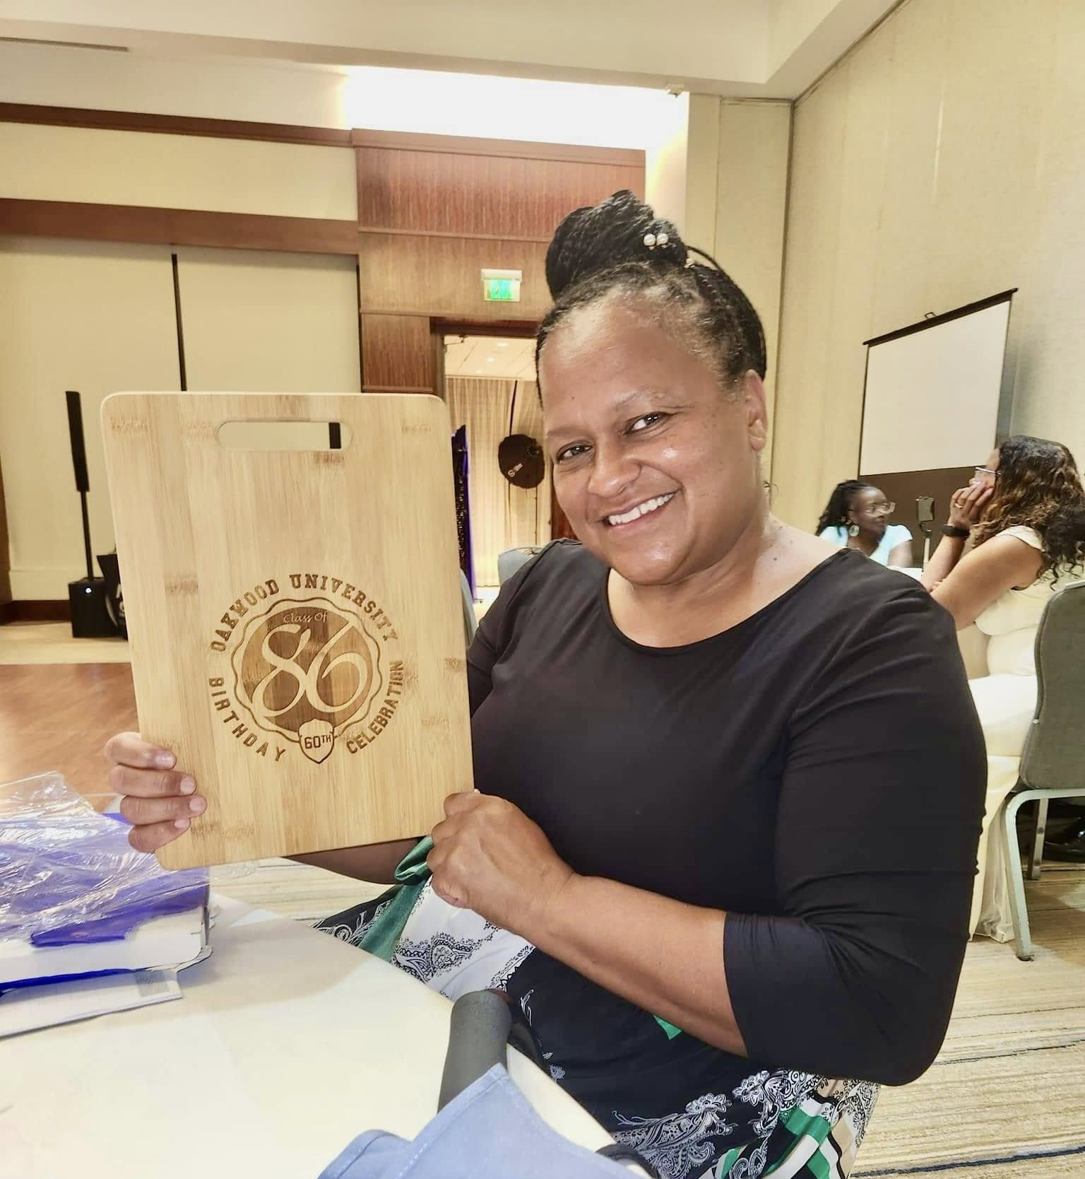

Slide 32
